Slide 1
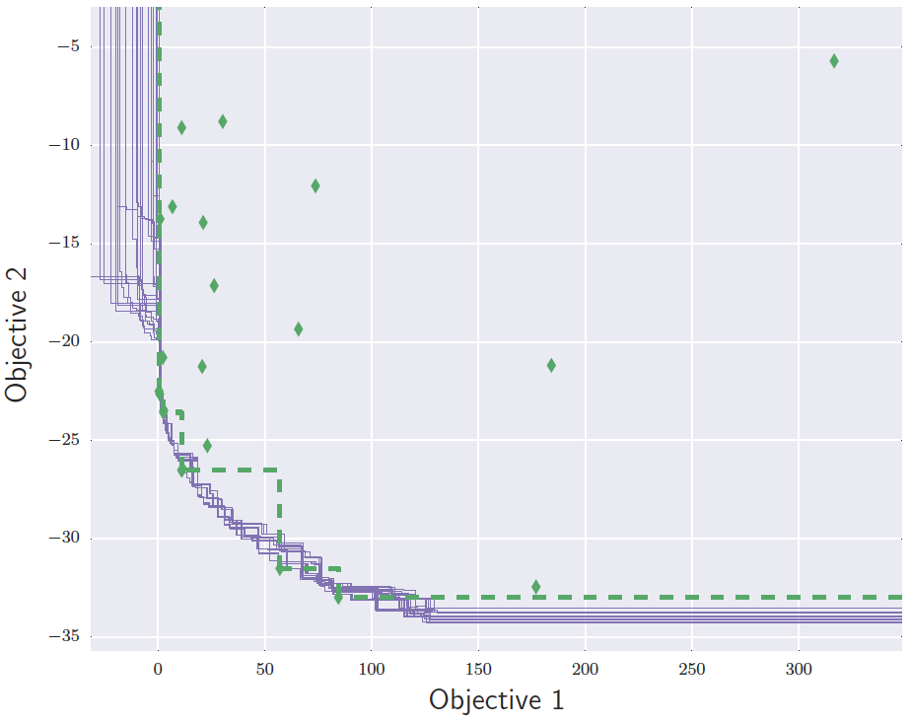
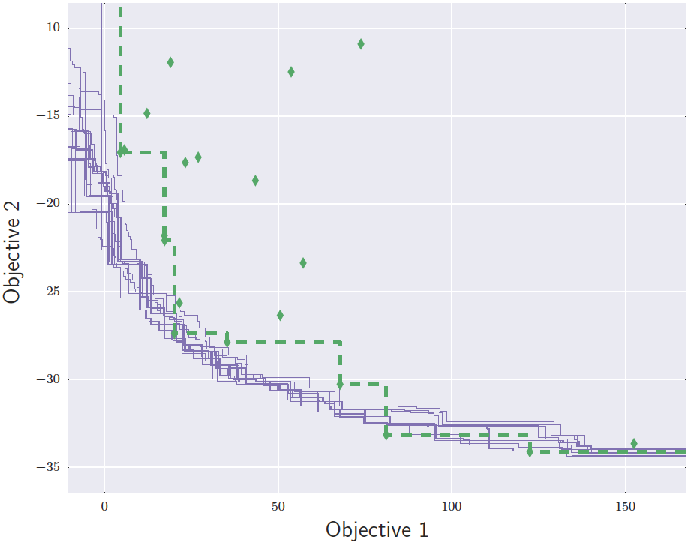
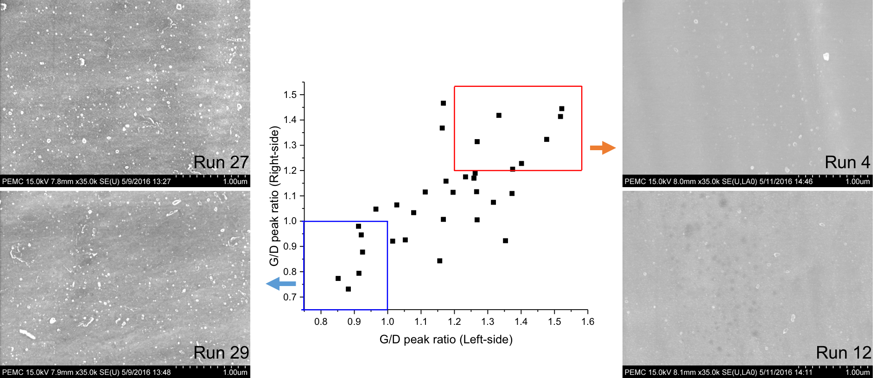
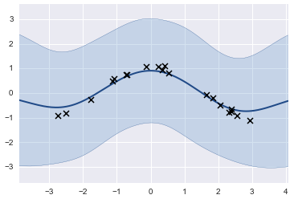
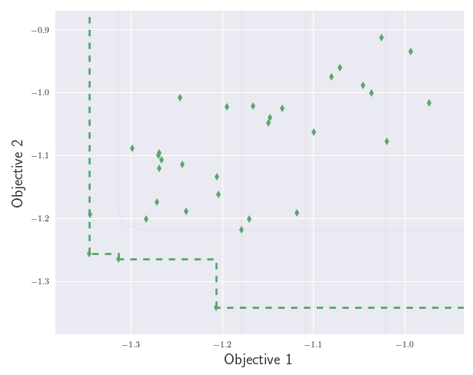
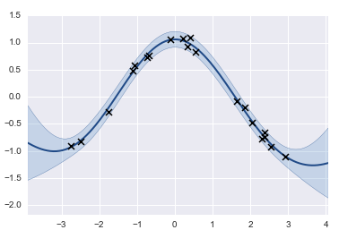
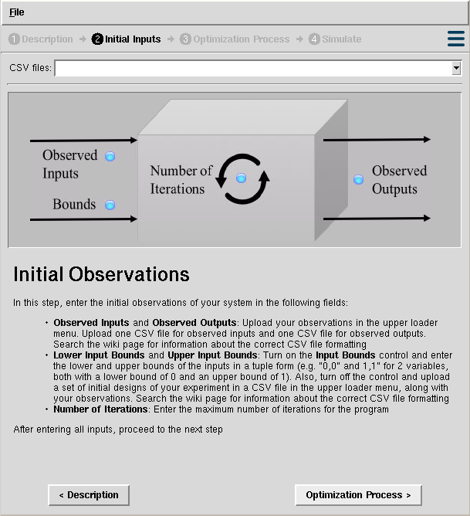
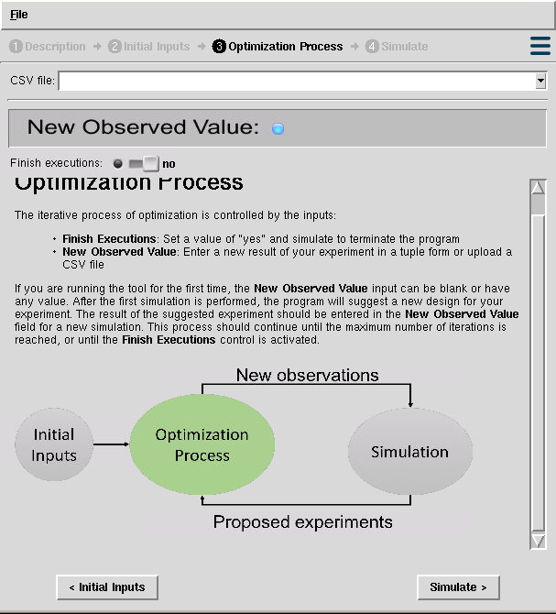
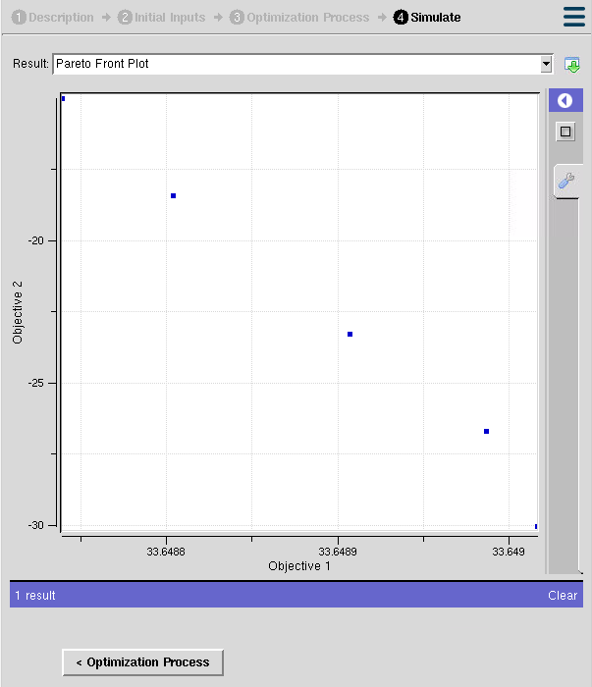
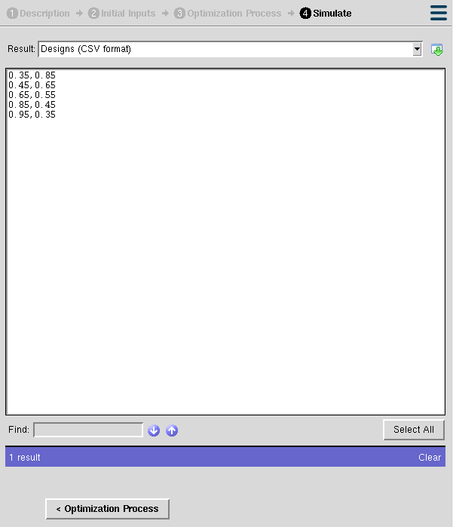

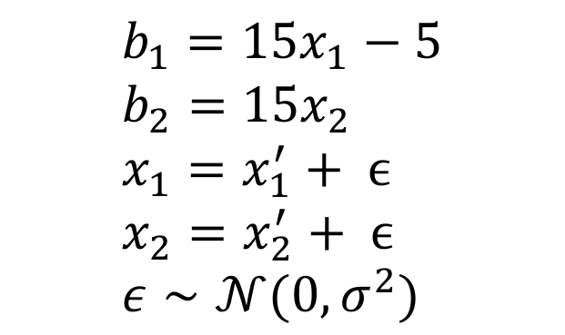
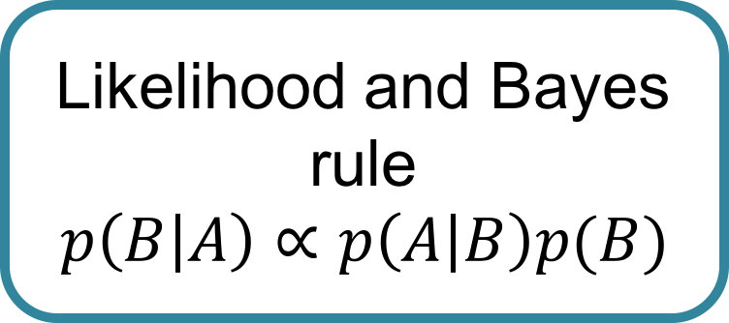
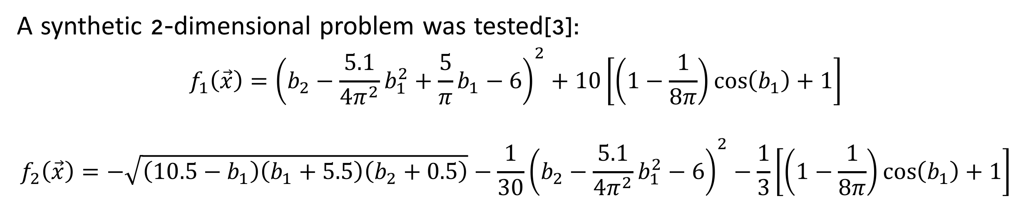
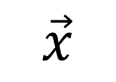
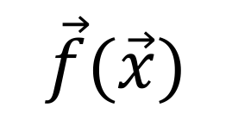
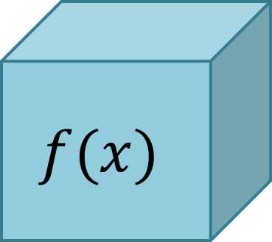


Gaussian Process Regressions for Objective Surrogates in Stochastic Multi-Objective Optimization
Juan Sebastian Martinez*, Piyush Pandita✝, Rohit Tripathy ✝, Ilias Bilionis ✝
*Department of Electric and Electronic Engineering, Universidad de Los Andes, Bogotá D.C, 111711, Colombia.
✝ Department of Mechanical Engineering, Purdue University, West Lafayette, Indiana, IN 47907, USA.
Background and Motivation…
The BGO Algorithm for Sequential Optimization
$$x$$
$$f(x)$$
$$y$$
Initial observations
Train GP surrogates
Project observations
Compute expected improvement
Time
Materials
…
Heat dissipation
Cost
…
Add new observation
Propose a design from a given set of designs
Pareto fronts for different cases
$$\min_{x}{f(x)}$$
Plasma CVD technique for graphene manufacturing over copper foils:
The optimization problem
General methodology
The Problem…
Gaussian process regressions to build objective surrogates:
Real life optimization problems in science and engineering share similar issues:
Multiple objectives.
Expensive experiments or evaluations of computer code.
Black box systems.
Noise in observations.
A GP is a probability measure on a function space such that any finite subset of points from the space are jointly Gaussian [1].
Prior Information and beliefs
Likelihood and Bayes rule
$$p\left(B | A\right)∝p\left(A | B\right)p(B)$$
G/D ratios on the sides of the copper foil
?
Data Observations
$$\vec{x}$$
$$\vec{f}(\vec{x})$$
Black box system
Posterior
Resulting Pareto front and set of chosen optimal experiments
Different approaches have been taken through evolutionary algorithms:
Large amount of observations required.
Uncertainty is not considered.
A Gaussian process regression
At the end…
Our Results…
Using Gaussian process regressions is an effective method for building objective surrogates under uncertainty.
This BGO formulation is useful for anyone (experimental or computational scientists) who need to optimize an expensive black box process with multiple objectives under a finite budget.
Our Objective…
Acknowledgments…
Majed A Alrefae and the team working with professor Tim Fisher for providing experimental data on the CVD process.
SMOOT (Stochastic Multi-Objective Optimization Tool):
https://nanohub.org/tools/smoot/
References
A synthetic 2-dimensional problem was tested[3]:
$$f_{1}\left(\vec{x}\right)={\left(b_{2}−\frac{5.1}{4π^{2}}b_{1}^{2}+\frac{5}{π}b_{1}−6\right)}^{2}+10\left[\left(1−\frac{1}{8π}\right)\cos\left(b_{1}\right)+1\right]$$
$$f_{2}\left(\vec{x}\right)=−\sqrt{\left(10.5−b_{1}\right)\left(b_{1}+5.5\right)\left(b_{2}+0.5\right)}−\frac{1}{30}{\left(b_{2}−\frac{5.1}{4π^{2}}b_{1}^{2}−6\right)}^{2}−\frac{1}{3}\left[\left(1−\frac{1}{8π}\right)\cos\left(b_{1}\right)+1\right]$$
[1] M. Seeger, Gaussian processes for machine learning. , vol. 14. 2004.
[2] Emmerich, Michael, and Jan-willem Klinkenberg. "The computation of the expected improvement in dominated hypervolume of Pareto front approximations." Rapport technique, Leiden University (2008).
[3] J. Parr, Improvement criteria for constraint handling and multiobjective optimization . PhD. thesis, University of Southampton, 2013.
$$b_{1}={15x}_{1}−5 \\ b_{2}={15x}_{2} \\ x_{1}=x_{1}^{′}+ ϵ \\ x_{2}=x_{2}^{′}+ ϵ \\ ε∼𝒩(0,σ^{2})$$
Pareto Front

